Slide 1
Frameworks, Methodologies, Ontologies and Taxonomies
Wasn’t that a mouthful?
Copyright © 2013 Curt Hill

Slide 2

Terms
In this course a number of terms will be bandied about
  Ontologies
  Taxonomy
  Frameworks
  Methodologies
Some think these interchangeable but they are not
Lets consider some working definitions
Copyright © 2013 Curt Hill

Slide 3
Ontology
  That department of the science of metaphysics which investigates and explains the nature and essential properties and relations of all beings, as such, or the principles and causes of being.
  In computer science and information science, an ontology formally represents knowledge as a set of concepts within a domain, and the relationships between pairs of concepts. It can be used to model a domain and support reasoning about entities
Copyright © 2013 Curt Hill

Slide 4
Taxonomy
The practice and science of classification
When used as a noun it is a particular classification
  Carl Linnaeus was the first to work on the modern taxonomy in biology
    Today DNA is used to correct
  Bloom’s taxonomy of education
  Many others exist
Copyright © 2013 Curt Hill

Slide 5
Framework
An enterprise architecture framework is an architecture framework which defines how to organize the structure and views associated with an enterprise architecture
Copyright © 2013 Curt Hill

Slide 6
Methodolgy
Guiding system for solving a problem, with specific components such as phases, tasks, methods, techniques and tools.
  The analysis of the principles of methods, rules, and postulates employed by a discipline
  The systematic study of methods that are, can be, or have been applied within a discipline
  The study or description of methods
Copyright © 2013 Curt Hill

Slide 7
Why is this important?
We need to know something about the four most common EA frameworks:
  Zachman
  TOGAF
  FEA
  Gartner
One such thing is if they are a framework at all
Copyright © 2013 Curt Hill

Slide 8
Making Money
Organizations are supposed to save money by increasing efficiencies after having applied EA principles
Some make money by showing you how to do this
There are workshops and seminars for each of the four (as well as others)
  This is how Zachman and Gartner among others make their money
Copyright © 2013 Curt Hill

Slide 9
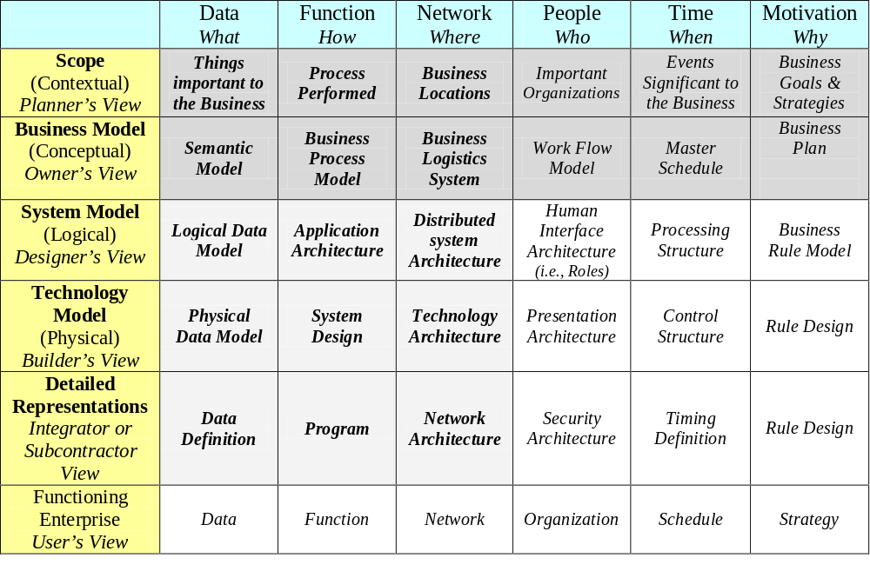
Zachman
Copyright © 2013 Curt Hill

Slide 10
What it does
Columns represent questions
  Who, what, when, …
Rows represent perspective or viewpoint
  Planner, owner, designer, …
Strength:
  Complete view of categories to examine
Weakness:
  No process is suggested
Copyright © 2013 Curt Hill
Notes:
Several slides derived from PPT by Bill Webb, Steven Young of University of Tampa and Sam Joseph of Gartner given at Tampa Bay Technology Leadership Association – November 2007

Slide 11
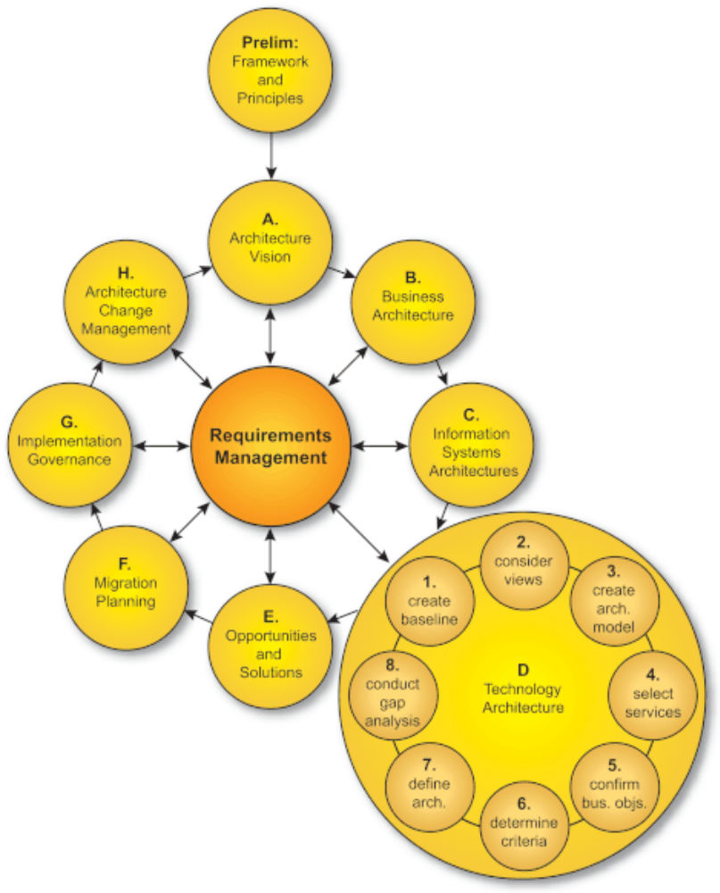
TOGAF
Copyright © 2013 Curt Hill

Slide 12
TOGAF
Divides EA into four architectures
  Business
  Application
  Data
  Technical
Strength:
  Process for developing an architecture.
  Flexibilty
Weakness:
  No specific end result
Copyright © 2013 Curt Hill

Slide 13
FEA
Focus
Data
Applications
Technology
Perspective
Architecture
Architecture
Architecture
(entities =
(activities =
(locations =
what
)
how
)
where
)
Planner’s View
Data Obje
cts
Business
Business
Business
Objectives/Scope
Processes
Locations
Architec
tu
re
Owner’s View
Semantic
Business
Business
Enterprise Model
Model
Process Model
Logistics
System
Designer’s View
Logical Data
Application
Deployment
Information
Model
Architecture
Architecture
Systems Model
Builder’s View
Physical Data
Systems Design
Technology
Design
Technology Model
Model
Architecture
Architecture
Subcontractor’s
Supporting
View
Data
Software,
Network
Detailed
Definitions
Applications &
Architectures
Specifications
Operating
Systems
Copyright © 2013 Curt Hill

Slide 14
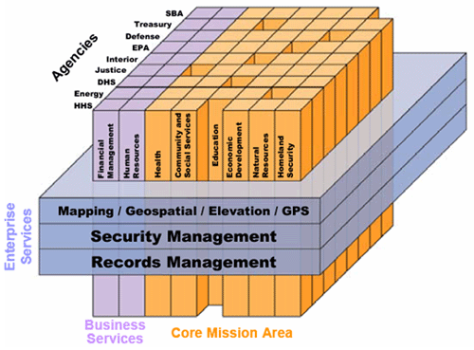
FEA Segment Map
Copyright © 2013 Curt Hill

Slide 15
FEA
Four step process
  Architectural Analysis
  Architectural Definition
  Investment and Funding Strategy
  Program-Management Plan and Execute Projects
Strength:
  Clearly defines output and provides a process for creating a framework
Weakness:
  The government has a different architecture than most businesses
Copyright © 2013 Curt Hill

Slide 16
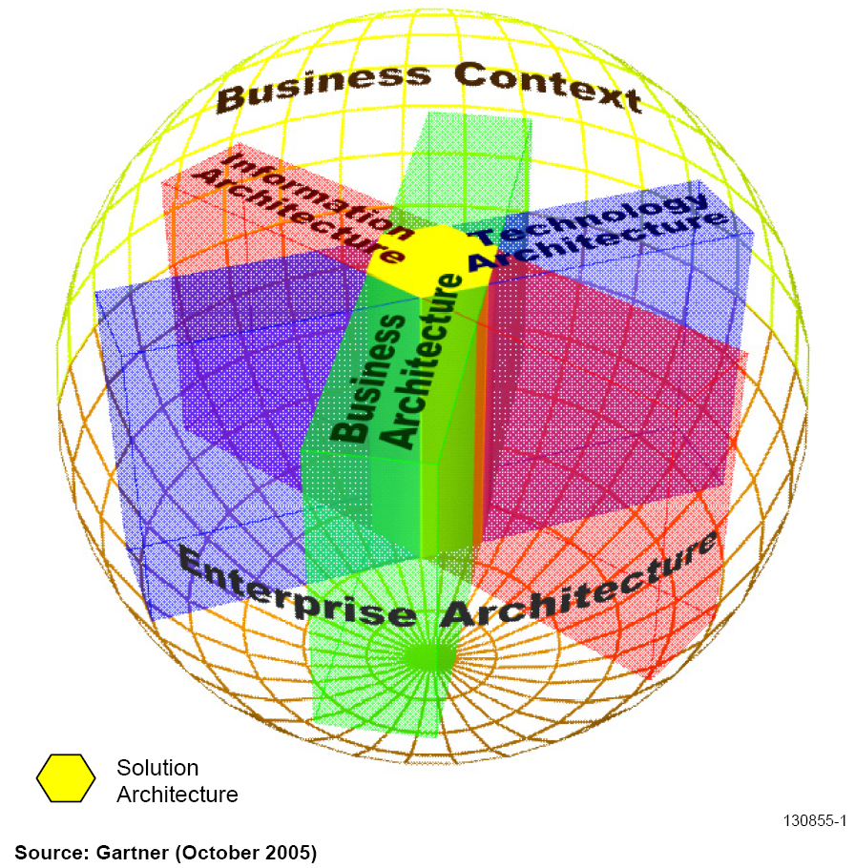
Gartner
Copyright © 2013 Curt Hill
Notes:
http://www.google.com/url?sa=t&rct=j&q=&esrc=s&source=web&cd=3&cad=rja&ved=0CFEQFjAC&url=http%3A%2F%2Fwww.tbtla.org%2Fdocs%2FTBTLAPresentationEnterpriseArchitecture11_2007.ppt&ei=JZrUUMTTEO2A2QXWqoHgBw&usg=AFQjCNEe_mz7eqCiozO9bpEgRDRpUZVyhQ&bvm=bv.1355534169,d.b2I

Slide 17
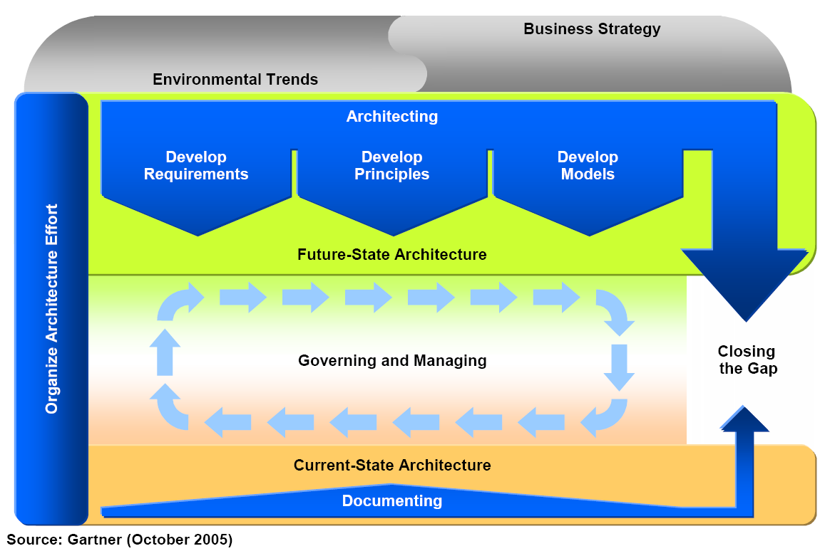
Gartner Process
Copyright © 2013 Curt Hill

Slide 18
Gartner
Three primary viewpoints
  Enterprise Business Architecture
  Enterprise Information Architecture
  Enterprise Technology Architecture
Strength:
  Practice guidance
  Maturity model
  Business focus
Weakness:
  Information availability
  Reference models
Copyright © 2013 Curt Hill

Slide 19
Opinion
Roger Session’s did a study available at:
      http://msdn.microsoft.com/en-us/library/bb466232.aspx
He does not believe any of these are actually frameworks
  See the next slide
This should illustrate that we always have a problem with word definition
  Much worse when Business and IT talk
Copyright © 2013 Curt Hill

Slide 20
Session’s Take
Zachman Framework for EA
  A taxonomy
  Zachman calls it an ontology
TOGAF
  EA process
FEA
  Prescriptive methodology
Gartner
  EA practice
Copyright © 2013 Curt Hill

Slide 21
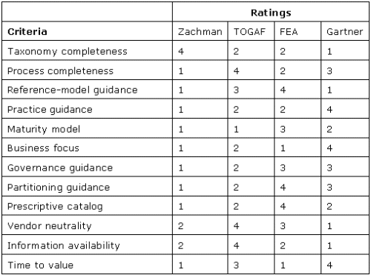
Session’s Comparison
Ratings: 1 is poor, 4 is good
Copyright © 2013 Curt Hill
Notes:
http://msdn.microsoft.com/en-us/library/bb466232.aspx

Slide 22
Finally
There are many other frameworks as well
The textbook favors the EA³ Cube
With that under control we have to start looking at some of these
Copyright © 2013 Curt Hill

